Slide 1

Introduction to PL/SQL
By
Krishnaprakash N
GBS IT Innovation Quality

Slide 2
What Is PL/SQL?
PL/SQL stands for Procedural Language/SQL
PL/SQL extends SQL by adding constructs found in procedural languages, resulting in a structural language that is more powerful than SQL
PL/SQL is a modern, block-structured programming language
PL/SQL provides several features that make developing powerful database applications very convenient
The basic unit in PL/SQL is a block. All PL/SQL programs are made up of blocks, which can be nested within each other

Slide 3
What Is PL/SQL?
PL/SQL blocks can have both SQL data manipulation language(DML), and data definition language (DDL) statements
PL/SQL provides procedural constructs, such as loops and conditional statements, that are not available in standard SQL
PL/SQL offers features such as Data Encapsulation, Exception Handling, Information Hiding, Object Orientation

Slide 4
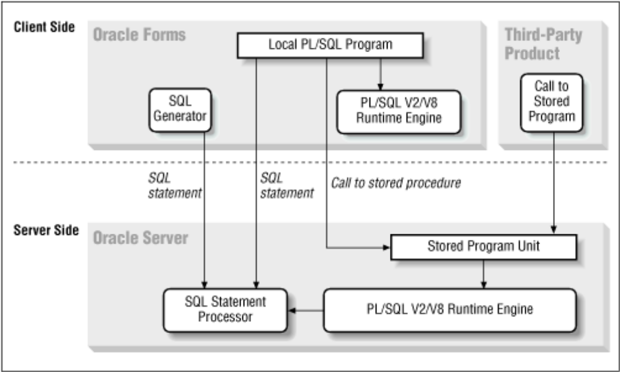
Architecture

Slide 5
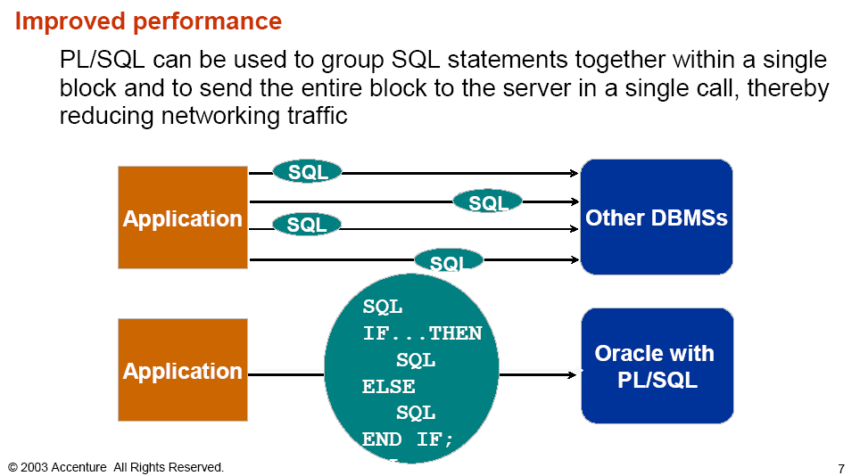
Benefits of PL/SQL
Improved performance
PL/SQL can be used to group SQL statements together within a single block
and to send the entire block to the server in a single call, thereby reducing
networking traffic

Slide 6
…Benefits of PL/SQL
Group logically related statements within blocks
Nest sub-blocks inside larger blocks to build powerful programs
Break down a complex problem into a set of manageable, well-defined, logical modules and implement the modules with blocks
PL/SQL is portable. Can be invoked from other environments
You can program with procedural language control structures

Slide 7
…Benefits of PL/SQL
Error Handling
Improved data security and integrity
Improved performance allows you to :
  Avoid reparsing for multiple users by exploiting the shared SQL area
  Avoid PL/SQL parsing at run time by parsing at compile
  time
  Reduce the number of calls to the database and decrease network traffic by bundling commands

Slide 8
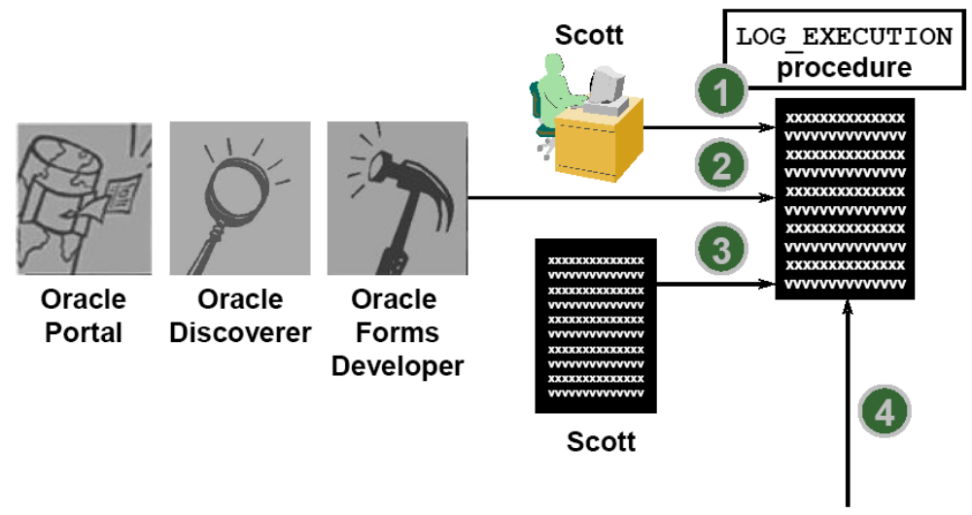
Invoking Stored program units

Slide 9
Block Structure…
A PL/SQL block consists of
  an optional declaration section
  an execution section and
  one or more optional exception handler sections
Declaration section declares PL/SQL variables, exceptions, and cursors
Execution section contains PL/SQL code and SQL statements, control
structures (loops), conditional statements
Exception handler section contain code that is called when the exception is
raised, either as a predefined PL/SQL exception or as an exception that you
define

Slide 10
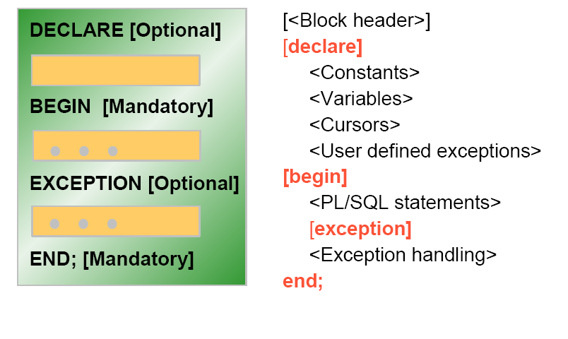
…Block Structure

Slide 11
Types of PL/SQL
Anonymous block
Stored Procedure
Function
Package
Trigger

Slide 12
Anonymous Block
An anonymous block is a PL/SQL program unit that has no name
An anonymous block
  cannot take input arguments and return output values
  cannot be called concurrently by multiple users
  is not stored in the data dictionary
Anonymous blocks are usually used interactively from a tool, such as SQL*Plus, or in a precompiler, OCI, or SQL*Module application
They are usually used to call stored procedures or to open cursor variables

Slide 13
Display output from Stored Procs
Package DBMS_OUTPUT enables you to print / display output from PL/SQL
blocks and subprograms
The procedure put_line outputs information to a buffer in the SGA. You display
the information by setting SERVEROUTPUT ON in SQL*Plus
SQL> SET SERVEROUTPUT ON
SQL> BEGIN
2 DBMS_OUTPUT.PUT_LINE( ‘Hello World‘ );
3 END;
4 /
Hello World
PL/SQL procedure successfully completed

Slide 14
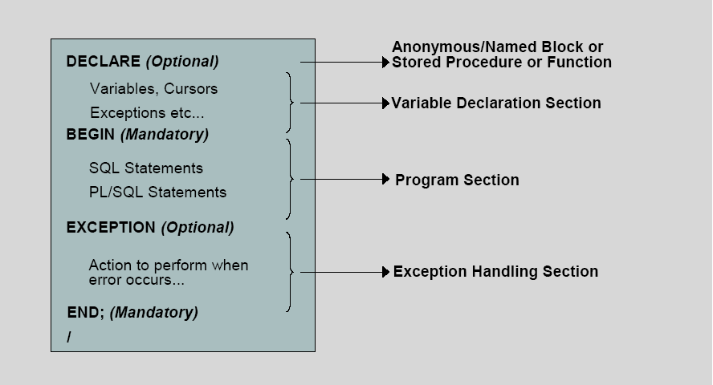
PL/SQL Block and Its Sections

Slide 15
Significance of Variables
Variables can be used for:
  Temporary storage of data
  Manipulation of stored values
  Reusability
  Ease of maintenance
This is facilitated by the way variables are handled in PL/SQL:
Variables are declared and initialized in the declaration section
Variables are assigned new values in the executable section
Values are passed to PL/SQL blocks through parameters
Output variables are used to view the results

Slide 16
Types Of Variables
PL/SQL variables:
  Scalar
  Composite
  Reference
  LOB(Large Objects)‏
Non-Pl/SQL Variables : Bind Variables

Slide 17
Base Scalar Data Types
CHAR
VARCHAR2
LONG
LONG RAW
NUMBER
BINARY_INTEGER
PLS_INTEGER
BOOLEAN

Slide 18
Variable initialization and Keywords
Assignment operator(:=)‏
DEFAULT keyword
NOT NULL constraint
Syntax:
identifier := expr;
Examples:
V_name := 'Sella';

Slide 19
Examples…
Example1:
SQL> set serveroutput on
SQL> BEGIN
2 dbms_output.put_line(’Welcome to PL/SQL’);
3 END;
4 /

Slide 20
…Examples
Example2:
  DECLARE
  Emp_number INTEGER := 7369;
  Emp_name VARCHAR2(10);
  BEGIN
  SELECT Ename INTO Emp_name FROM Emp
  WHERE Empno = emp_number;
  DBMS_OUTPUT.PUT_LINE('Employee name is ' || Emp_name);
  EXCEPTION WHEN NO_DATA_FOUND THEN
  DBMS_OUTPUT.PUT_LINE('No such employee: ' ||
  Emp_number);
  END;
  /

Slide 21
Using Bind Variables
A bind variable is a variable that you declare in a host environment. Bind variables can be used to pass run-time values, either number or character, into or out of one or more PL/SQL programs.
To reference a bind variable in PL/SQL , you must prefix its name with a colon(:)‏
  VARIABLE g_salary NUMBER
  BEGIN
  SELECT Sal
  INTO :g_salary
  FROM emp
  WHERE empno = 7844;
  END;
  /
  PRINT g_salary

Slide 22
Commenting Code
Prefix single-line comments with two dashes (--).
Place multiple-line comments between the symbols /*and */
Example :
  Declare
  V_sal Number(9,2);
  Begin
  /* Compute the annual salary based on the
  monthly salary*/
  v_sal := 2500*12;
  -- This is the end of the block
  End;
  /

Slide 23
The %TYPE Attribute
Declare a variable according to:
  A database column definition
  Another previously declared variable
Syntax
  identifier Table.column_name%TYPE;
Examples:
  V_name emp.ename%type;
  V_sal emp.sal%TYPE;

Slide 24
Using the %ROWTYPE Attribute
The %ROWTYPE attribute provides a record type that represents a row in a table or view. Columns in a row and corresponding fields in a record have the same names and data types.
However, fields in a %ROWTYPE record do not inherit constraints, such as the NOT NULL or check constraint, or default value

Slide 25
…Using the %ROWTYPE Attribute
Example:
DECLARE
emp_rec emp%ROWTYPE;
BEGIN
  -- We know EMP_REC can hold a row from the EMP table.
  SELECT * INTO emp_rec FROM emp WHERE ROWNUM < 2;
  IF emp_rec.deptno = 20 AND emp_rec.ename = 'JOHNSON' THEN
  emp_rec.sal := emp_rec.sal * 1.15;
  END IF;
END;

Slide 26
Thank You

